Slide 1
FSW-100 Introduction to Web Development
HTML and CSS
Week 1 – Course Overview and HTML

Slide 2
“If you think math is hard, try web design.”
– Trish Parr

Slide 3
Welcome to FSW-100
Instructor Welcome
Weekly Overview
Syllabus Overview
Web Meetings

Slide 4
GitHub Repository Setup
Create repository on github.com called “fsw-100”
Locate the green “Code” button and copy the https://... address.
In VS Code, open a bash terminal window and make sure that the working directory is the folder you are storing your work for this program.
Type “git clone <url>” where <url> is the one you copied in step 2.
Change directory to “fsw-100”
Create a directory for each week following the file structure in Step 6 under week 1.
Change directory to week1.
Create a file called index.html in the week1 folder.
To add these changes to git hub, type “git add –A”. Must be an uppercase A.
Check the git status with “git status”
Commit changes with
git commit –m “Added index.html to week1 folder”
Push changes to Github with “git push”

Slide 5
HTML Basics
What is HTML?
Hypertext Markup Language
What is a Markup Language?
A markup language is a computer language that uses tags to define elements within a document. It is human-readable, meaning markup files contain standard words, rather than typical programming syntax. While several markup languages exist, the two most popular are HTML and XML.
XML is used for storing structured data, rather than formatting information on a page. While HTML documents use predefined tags, XML files use custom tags to define elements.
HTML is a markup language used for creating webpages. The contents of each webpage are defined by HTML tags.

Slide 6
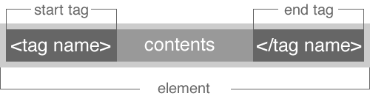
HTML Tags
An HTML tag is used to indicate the beginning and end of an HTML element in an HTML document.
Most elements require a beginning and end tag, with the content placed between the tags.

Slide 7
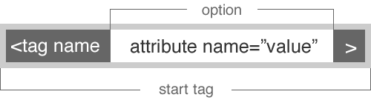
HTML Tags
Some elements don't have content in them, and hence they don't have a closing tag. These tags usually require attributes specified on the start tag.
<img src=“photo.jpg” width=300 height=200>

Slide 8
HTML Tags
Elements can be nested inside each other.
<p>I'm coding my first <u>HTML</u> page and I love <b>going to the beach!</b></p>

Slide 9
HTML Tags
Using VS Code to create your first HTML Page.
Open the file called “index.html” in the week 1 folder.
Type ! and then hit the [tab] key.
The file should now be populated with some default HTML boilerplate tags.

Slide 10
HTML Boilerplate Tags
The <html> element represents the root of an HTML document. The lang attribute is added to specify the document’s language for all the text on the page.
The <head> element is a container for metadata (data about data) and is placed between the <html> tag and the <body> tag. Metadata is not displayed. Metadata typically define the document title, character set, styles, scripts, and other meta information. The following elements can go inside the <head> element:
<title> (required in every HTML document)
<style>
<base>
<link>
<meta>
<script>
<noscript>

Slide 11
HTML Boilerplate Tags
The <title> tag defines the title of the document. The title must be text-only, and it is shown in the browser's title bar or in the page's tab. The <title> tag is required in HTML documents! The contents of a page title is very important for search engine optimization (SEO). The page title is used by search engine algorithms to decide the order when listing pages in search results.
The <body> tag defines the document's body.
The <body> element contains all the contents of an HTML document, such as headings, paragraphs, images, hyperlinks, tables, lists, etc. Note: There can only be one <body> element in an HTML document.

Slide 12
HTML Tags – Common Tags
The <h1> to <h6> tags are used to define headings. <h1> defines the most important heading. <h6> defines the least important heading. The size of the text will change with each heading level. 1 is the largest, 6 is the smallest. Size 4 is the size of default text in the document (1em/16px).
The <p> tag defines a paragraph. Browsers automatically add a single blank line before and after each <p> element.
The <b> tag specifies bold text without any extra importance.

Slide 13
HTML Tags
Every HTML element has a default display value. They are either block or inline.
A block-level element always starts on a new line and takes up the full width available (stretches out to the left and right as far as it can based on its parent’s dimensions).
https://developer.mozilla.org/en-US/docs/Web/HTML/Block-level_elements
An inline element does not start on a new line and only takes up as much width as necessary.
https://developer.mozilla.org/en-US/docs/Web/HTML/Inline_elements
An inline element cannot contain a block-level element.

Slide 14
HTML Tags – Common Tags
The <span> tag is used to group and mark up a part of a text . It is an inline container.
The <div> tag (division) is used to define a section of an HTML document. It is a block-level element. Probably one of the most used elements in an HTML document. By default, a browser always places a line break before and after the <div> element.

Slide 15
HTML Tags – Common Tags
The <ul> tag (Unordered List) defines an unordered (bulleted) list.
Use the <ul> tag together with the <li> (List Item) tag to create unordered lists.
The <li> tag defines a list item. The <li> tag is used inside Ordered Lists(<ol>), unordered lists (<ul>), and in menu lists (<menu>).

Slide 16
HTML Tags – Common Tags
The <img> (image) tag is used to embed an image in an HTML page.
Images are not technically inserted into a web page; images are linked to web pages. The <img> tag creates a holding space for the referenced image.
The <img> tag has two required attributes and several optional attributes:
src - Specifies the path to the image
alt - Specifies an alternate text for the image, if the image for some reason cannot be displayed. Required for SEO and accessibility.
<img src=“beach.jpg” alt=“White Sandy Beach”>

Slide 17
Free Use Image Websites
https://unsplash.com/
https://pexels.com/
https://pixabay.com/
https://stocksnap.io/

Slide 18
HTML Tags – Common Tags
The <a> tag (Anchor) defines a hyperlink, which is used to link from one page to another or to a different section within the same document.
The most common attribute used with the <a> element is the href (hypertext reference)attribute, which indicates the link's destination.
<a href=“http://www.google.com”>Google.com</a>
The <a> tag can also be used to create an anchor to a subsection with your page.
<a name=“contact”></a>
<a href=“#contact”>Contact Us</a>

Slide 19
Whitespace in HTML
Whitespace is any string of text composed only of spaces, tabs or line breaks (carriage returns or line feeds).
In HTML, whitespace is largely ignored.
Whitespace between words is treated as a single character.
Example
<h1> Hello World! </h1>
becomes
<h1>Hello World!</h1>

Slide 20
Whitespace in HTML
A commonly used entity in HTML is the non-breaking space: &nbsp;
A non-breaking space is a space that will not break into a new line.
Used when two words should be kept together.
Example:
10 pm or 55 mph
10&nbsp;pm or 55&nbsp;mph

Slide 21
Whitespace in HTML
To insert a single line break in text, use the <br> tag.
Useful in writing addresses or poems.
Example:
Bryan University<br>
350 W Washington St<br>
Tempe, AZ 85281

Slide 22
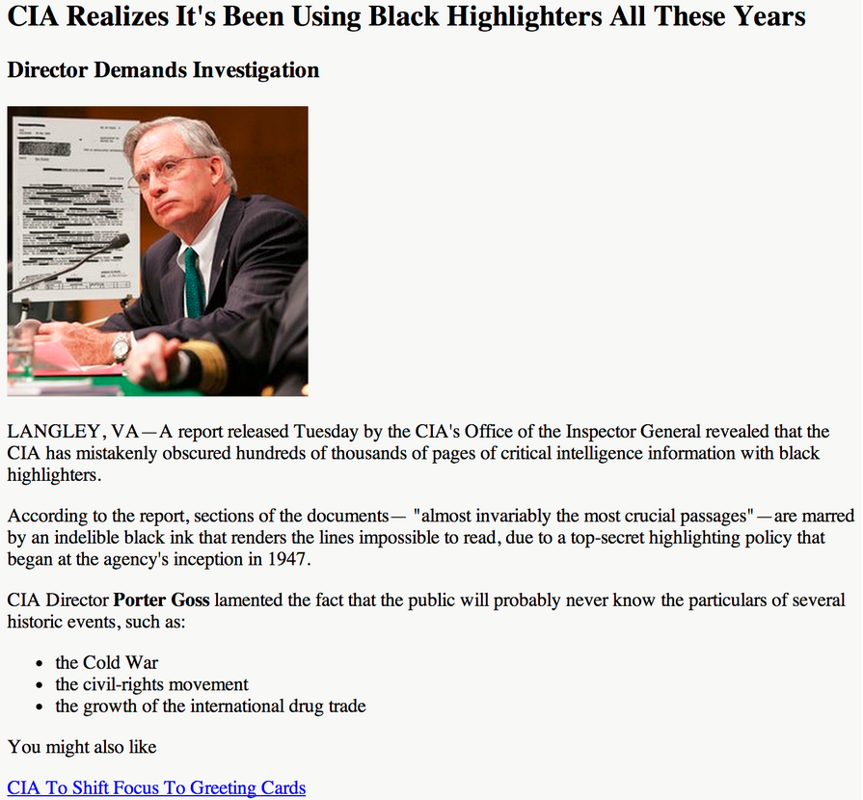
Upcoming Week 2 Assignment
Create a HTML5 Website

